Slide 1
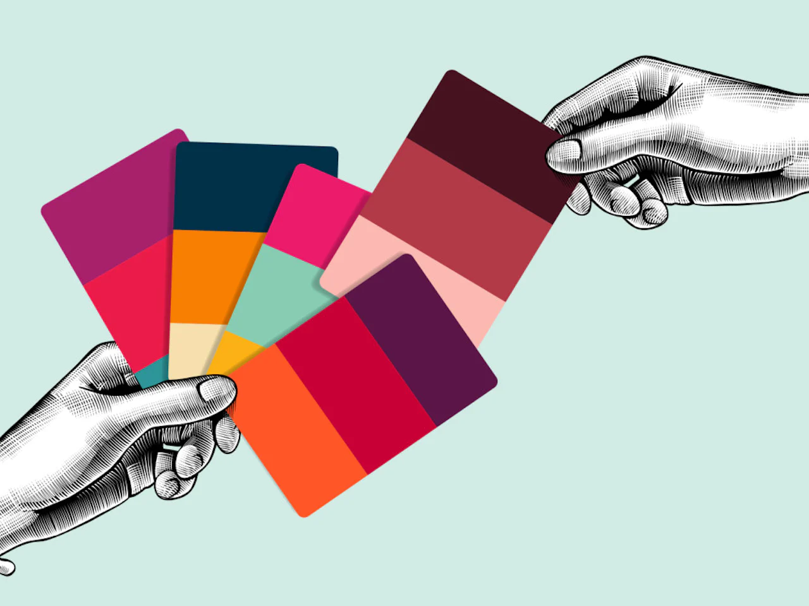
November 2022
Marketing Strategy using Stated Preferences
Aniket Patil, Ankit Muthiyan, Disha Gandhi, Harshit Jain, Kshitij Mahajan

Slide 2
DATASET DESCRIPTION
Personality traits, Views on life, & Opinions (57 columns)
Music Preferences (19 columns)
Movie Preferences (12 columns)
Hobbies & Interests (32 columns)
Phobias (10 columns)
Health Habits (3 columns)
Demographics (10 columns)
Spending Habits (7 columns)

Slide 3
ANALYSIS AREAS
What are the factors contributing to a person's feeling of Loneliness?
Loneliness
Life Struggles
Who is struggling more in their life and what factors influence it?
Drinkers vs Non-Drinkers
What are the choices and character traits of drinkers and non-drinkers?
What lifestyle habits and personality traits influence spending habits?
Spending Habits

Slide 4

What are the factors contributing to a person's feeling of Loneliness?

Slide 5
APPROACH
Cleaning
Processing
EDA
Machine Learning Implementation
Recommendations
Null values were removed.
Dummy values were created.
Class Segregation for Gender
Standardizing the train data
Visualizing with Gender, No of siblings
Correlation with other columns
Implemented Logistic Regression with other columns
Which habits and patterns most influence Loneliness among the youth.

Slide 6
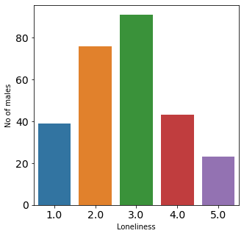
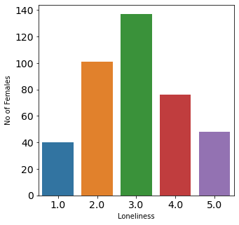
Loneliness VS Gender

Slide 7
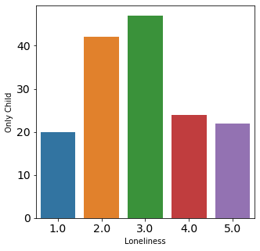
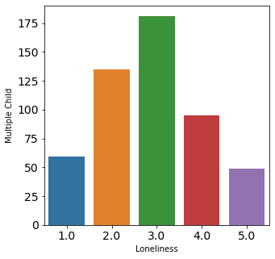
Loneliness VS No of Siblings

Slide 8
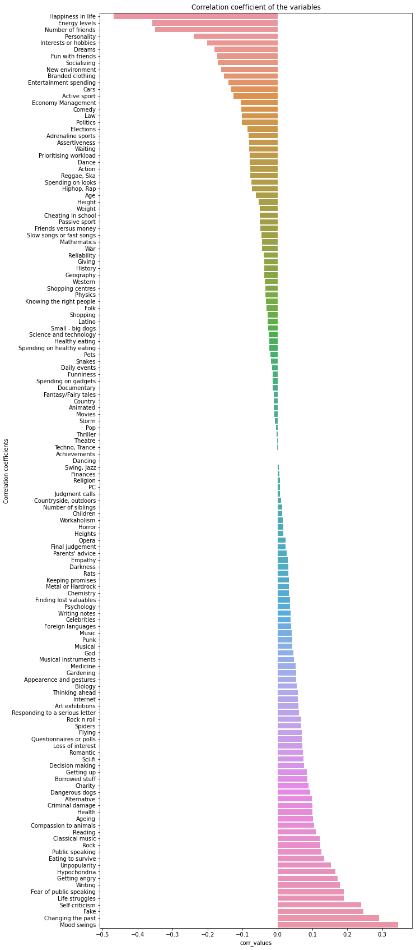
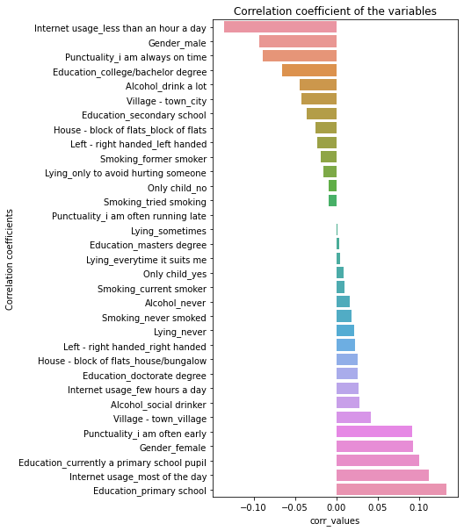
Correlation of Loneliness with other Features

Slide 9
MODELING & RECOMMENDATIONS
People who like spending time with friends, like active sports, geography, pets & entertainment can have low degree of Loneliness
71 variables were used and, accuracy rate of 71% achieved with (K-fold) test sets.
LOGISTIC REGRESSION
Topics to stay away from
People who like writing, have fear of public speaking, surf a lot on internet, enjoy using PC & spend a lot on gadgets can have high degree of Loneliness
We firstly transformed our original loneliness variable to a dummy variable.
Loneliness > 3 are considered as lonely.
Loneliness <= 3 are considered not lonely.
Notes:
Entertainment companies and travel agencies can target these groups as lonely youngsters are likely to spend their time and money on entertainment, travelling, and adventure sport. The Co-op Foundations and charitable organizations working to prevent and tackle youth loneliness can take these factors into consideration to help young people form stronger connections within their community.

Slide 10
Who is struggling more in their life and what factors influence it?

Slide 11
APPROACH
Cleaning
Processing
Finding Correlations
Recommendations
Null values were removed.
Dummy values were created from categorical variables
Standardizing the train data
Finding highest correlations between variables
Which habits and patterns most influence Life Struggles among the youth

Slide 12
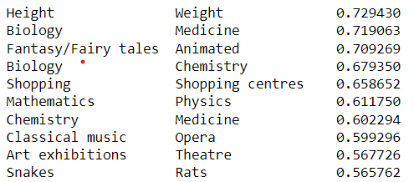
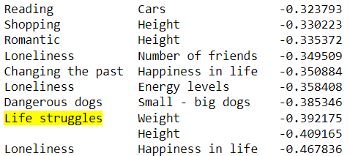
Top and bottom correlations between variables
Topics to stay away from
We see a negative correlation between Life struggles and Weight, Height. We explore further to understand the reasons behind this correlation.
Life struggles, height and weight are highly correlated with gender: women tend to have higher values of Life struggles, and lower height and weight
Negative correlation between Life struggles and height/weight was due to the female and male separation.

Slide 13
Predicting drinking habits based on a person's choices and character traits.

Slide 14
APPROACH
Cleaning
Processing
Machine Learning Implementation
Recommendations
Null values were removed.
Dummy values were created.
Class Segregation for Gender
Standardizing the train data
Implemented Decision Tree
Which habits and patterns most influence Loneliness among the youth.

Slide 15
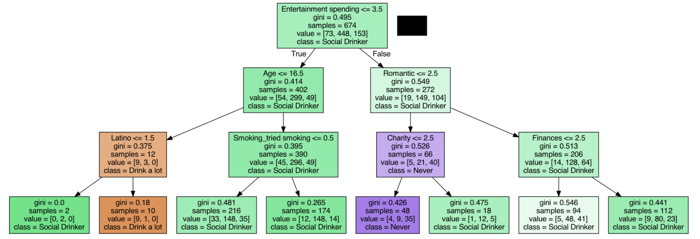
DECISION TREE VISUALIZATION

Slide 16
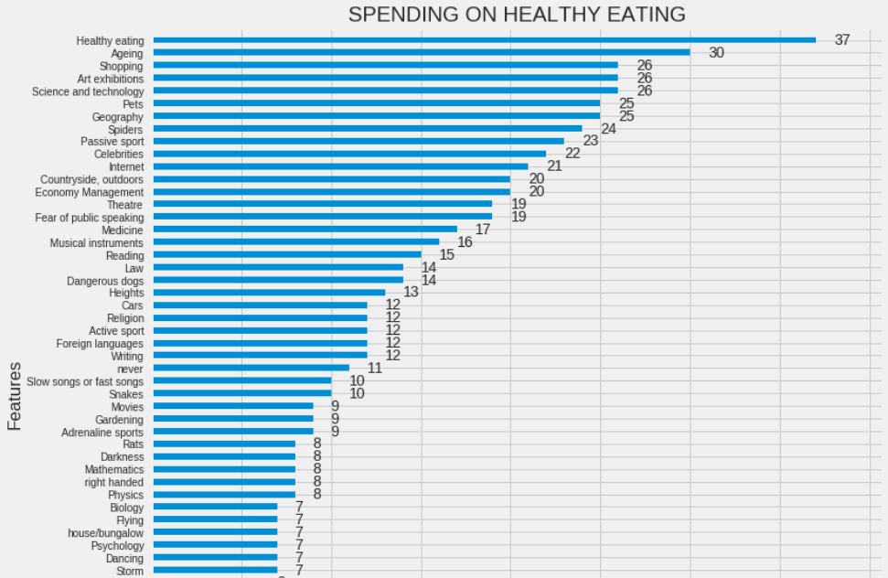
BOOSTED MODEL FEATURE IMPORTANCE

Slide 17
MODELING & RECOMMENDATIONS
It was startling to see underage drinkers as one of the most important splitting criteria on the decision tree. A large no of underage drinkers belong to the Latino category.
People with ages less than 16.5 had understandably low spending thresholds as compared to people who were older and spent big on entertainment.
Decision Tree
Topics to stay away from
Smoking cannot be used as a criterion to identify people who drink as the people who drink had an equal chunk of smokers and non-smokers.
It wasn't surprising to see people with a history of spending big also splurge money on drinks.
Notes:
Entertainment companies and travel agencies can target these groups as lonely youngsters are likely to spend their time and money on entertainment, travelling, and adventure sport. The Co-op Foundations and charitable organizations working to prevent and tackle youth loneliness can take these factors into consideration to help young people form stronger connections within their community.

Slide 18
Insights on Spending Habits

Slide 19
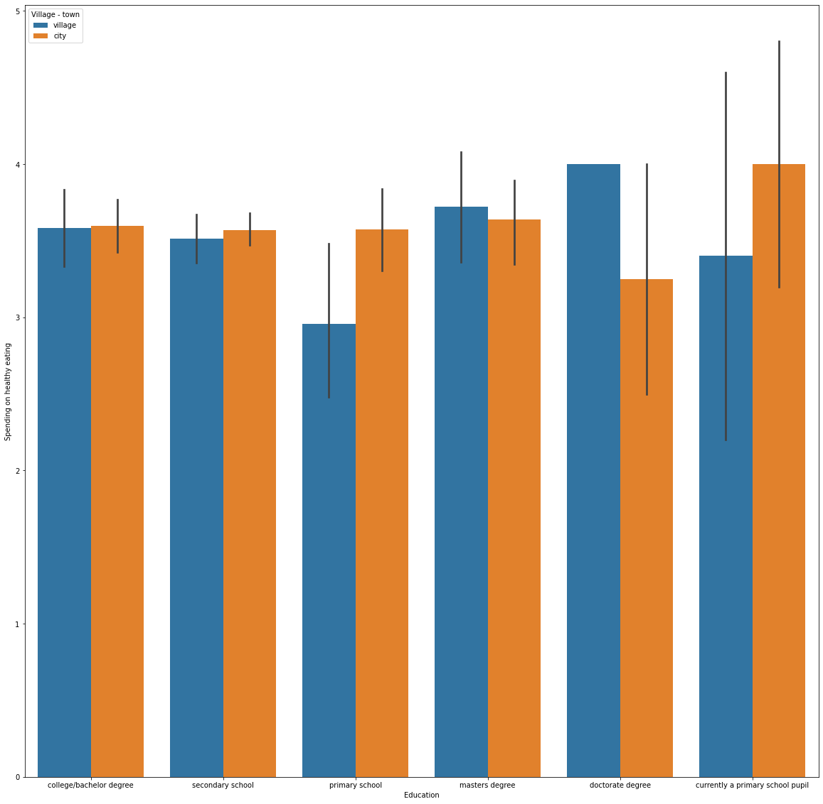
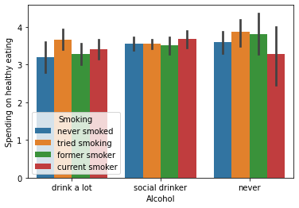
Correlation of Education with Spending on Healthy Eating
Correlation of Alcohol and Smoking with Spending on Healthy Eating
Notes:
As we can see here that people who have never had alcohol and have been former smokers spend more on healthy eating.These insights will help us during classification and prediction later on.
Here I have taken another feature to get insight on how the education and the place where they stay either village or town is likely to depend on they spending on Healthy eating
As we can see here that people are doing doctorate degree in a village and primary school pupil in city are most likely to spend on healthy food than others.

Slide 20
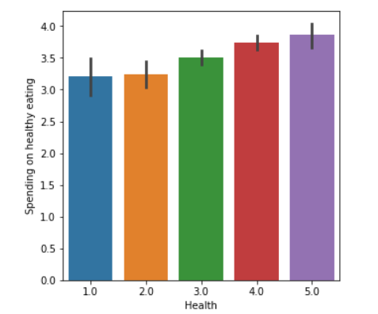
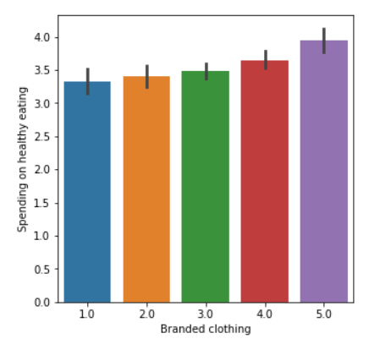
Correlation of Branded clothing with Spending on Healthy Eating
Correlation of Health with Spending on Healthy Eating
Notes:
We can see that healthy people spend more on healthy eating. And people who use branded clothing also spend more on healthy eating. This makes sense as these would be the people who are conscious of their image and would be willing to spend on branded clothing and healthy eating

Slide 21
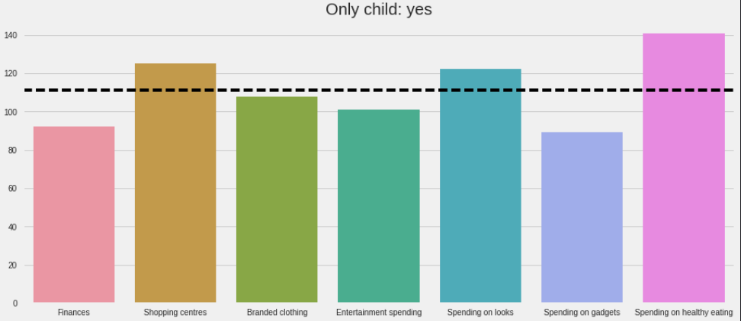
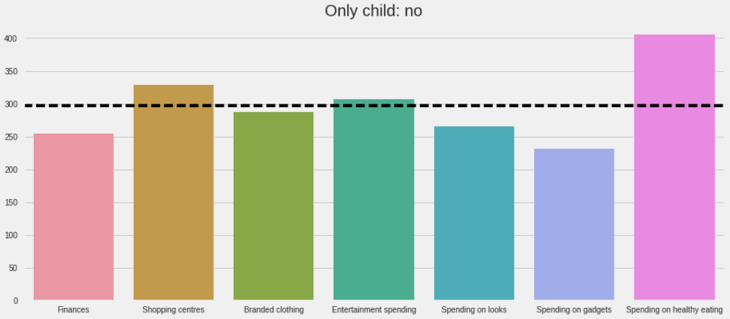
People who are only child tend to spend less generally on entertainment, gadgets, branded clothing and also spending on health
Only childs spend more than average on looks whereas those with siblings spend lesser than average on looks

Slide 22
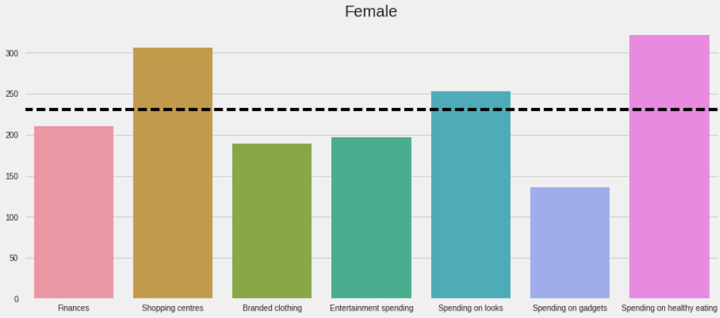
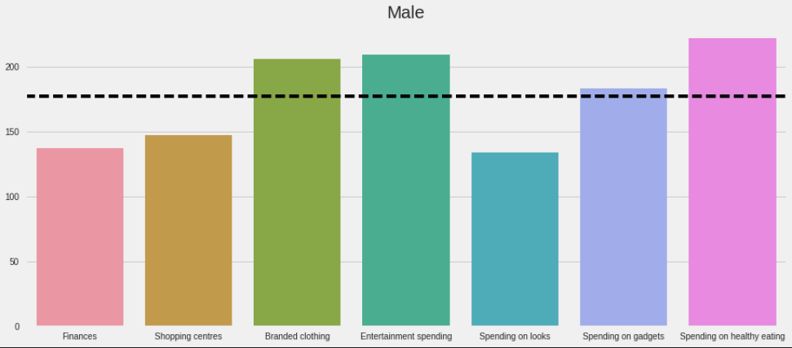
Men spend much more money than women on branded clothing.
Also, the average line suggests females spend more on looks.

